Slide 1
Team 10
AI-Powered Cyprus Sign Language Translator
Team: Makar Baskakov, Lev Maleta, Roman Ponomarenko
Date: 19th of June 2026
Venue: Frederick University, Limassol

Slide 2
Problem Overview
Communication Barriers in Online Services
Deaf and hard-of-hearing users can face difficulties when using online platforms such as university portals, appointment systems, public-service websites, and forms.
Most websites are built around written or spoken language. They usually do not support sign-language interaction.
For our MVP, we focus on a smaller problem: recognizing selected isolated signs and converting them into text inside the browser.
Notes:
The problem we are focusing on is communication barriers for deaf and hard-of-hearing users when they use online services. Many websites, such as university portals, appointment systems, public-service websites, and online forms, are mainly designed around written or spoken language. This creates a difficulty for users who mainly communicate through sign language, because most websites do not provide sign-language interaction. For this project, we are not trying to solve full sign-language translation. That would require a much larger dataset and more advanced language processing. Instead, our MVP focuses on a smaller and more realistic goal: recognizing selected isolated signs and converting them into text inside the browser.

Slide 3
Motivation
Our goal is to make online communication more accessible.
A browser extension is useful because it can work on top of existing websites. Users do not need to open a separate app or platform.
This approach can support simple communication tasks such as asking for help, filling forms, understanding selected words, and interacting with online services.
Notes:
Our goal is to make online communication more accessible for deaf and hard-of-hearing users. We decided to create a browser extension because it can work directly on websites. Users don't need to install a separate platform or switch between different applications. They can continue using the websites they already know and do everything on one screen. The idea is to help with simple everyday online interactions, so that everyone can communicate with each other without difficulties or discomfort. For example, our extension can assist users when filling out forms, understanding the context or phrases, asking for help, or interacting with online services. We believe this approach is practical, easy to use, and can make online communication a little more accessible for many people.

Slide 4
Solution
KNΓ Bridge
KNΓ Bridge is a browser-extension prototype for isolated sign recognition.
The user opens the extension, starts the camera, and shows one or more selected signs. The extension sends the frames to a Flask backend. MediaPipe extracts hand landmarks, and an LSTM model predicts the sign.
The result is displayed as text and can be inserted into a webpage.
Pipeline:
Webcam → Browser Extension → Flask API → MediaPipe → LSTM Model → Text
Notes:
Our solution is KNΓ Bridge, a browser-extension prototype for isolated sign recognition.
The system has two main parts: the browser extension and the local Flask backend.
The user starts the camera inside the extension and shows one or more selected signs.
The extension captures the video frames and sends them to the backend.
On the backend, MediaPipe is used to extract hand landmarks. These landmarks represent the position of key points on the hand.
Then, an LSTM model processes the landmark sequence and predicts the sign.
The predicted sign is shown as text in the extension, and the user can insert this text into a webpage.
The pipeline is: webcam, browser extension, Flask API, MediaPipe, LSTM model, and finally text output.

Slide 5
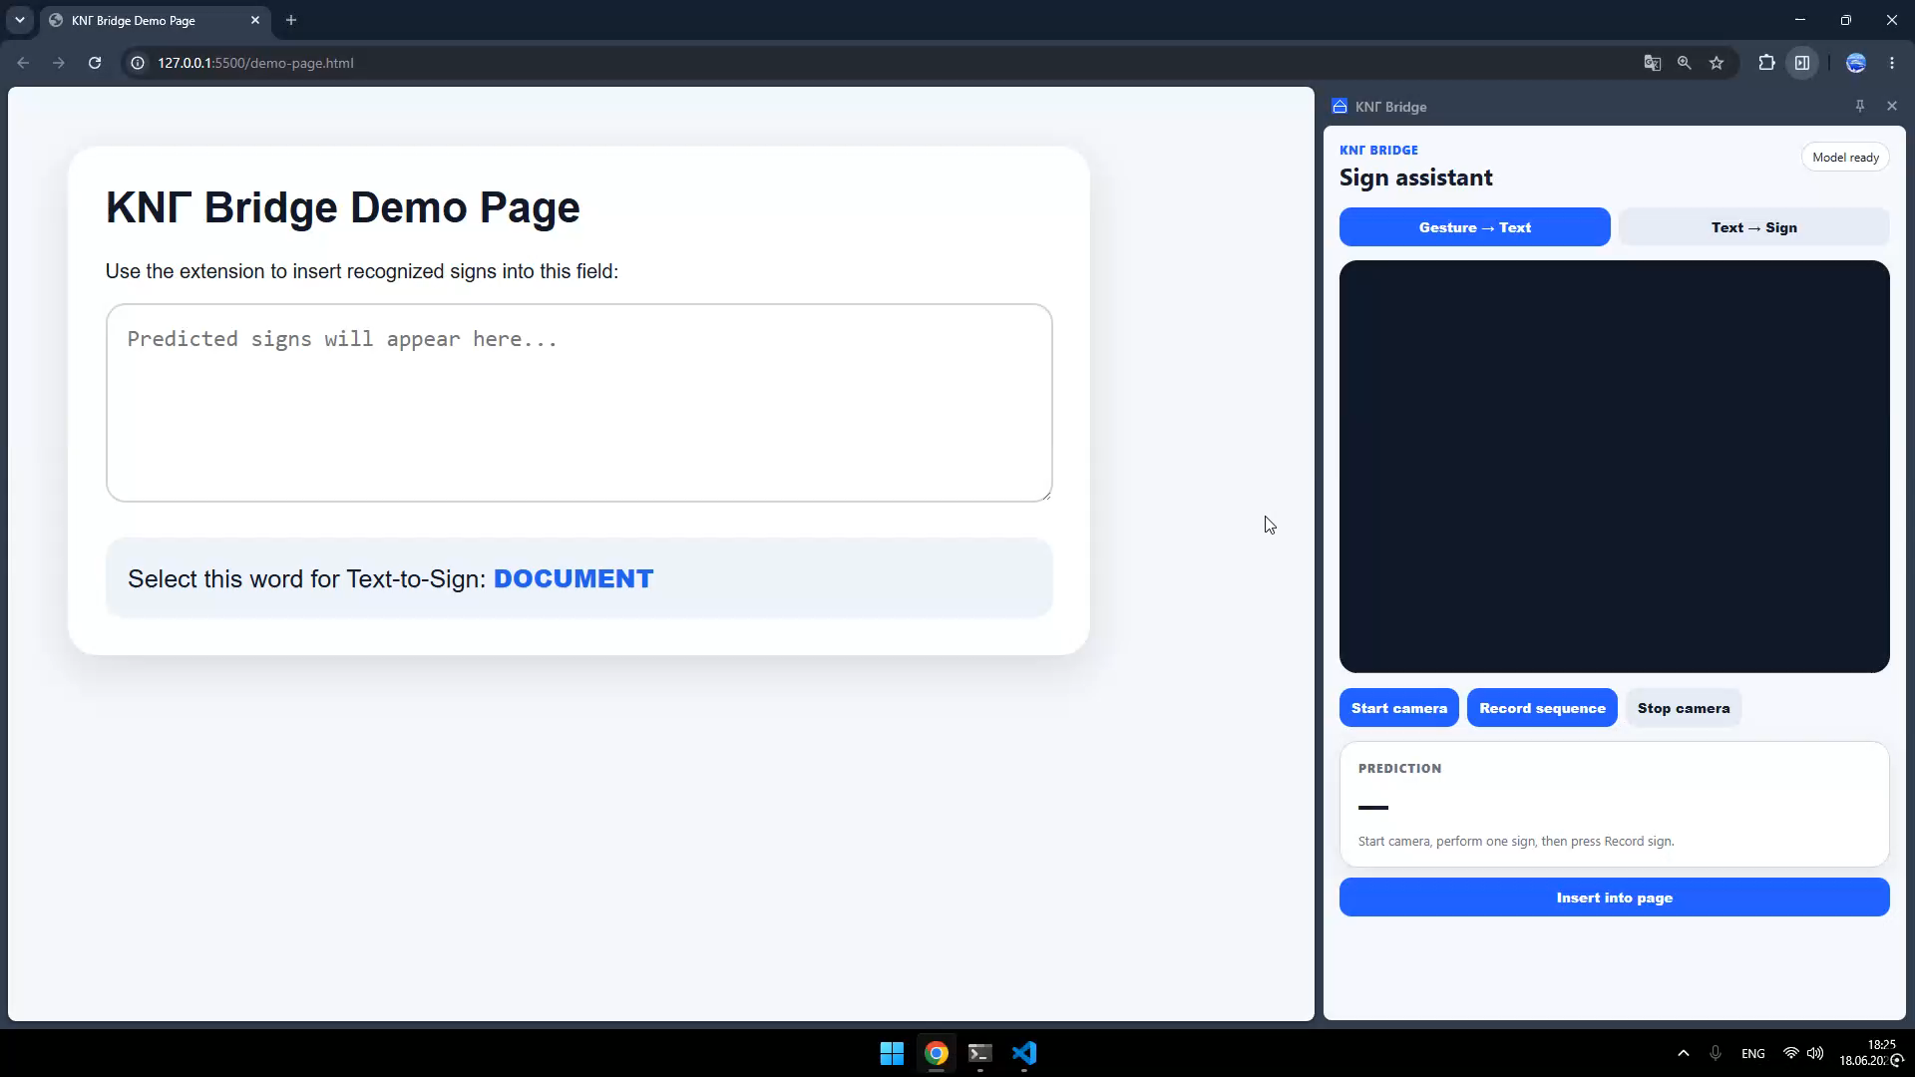
Demo Video
MVP Demo
Notes:
In the demo, we show the extension running, the webcam being used, selected signs being recognized, and the prediction appearing as text.
We also show the Text-to-Sign feature, where selected text can be connected to reference links for the corresponding sign.
It is important to mention that this is an MVP. It does not perform full continuous sign-language translation yet. The current goal is selected isolated signs, and future work would include a larger dataset, better accuracy, and testing with real KNΓ users.

Slide 6
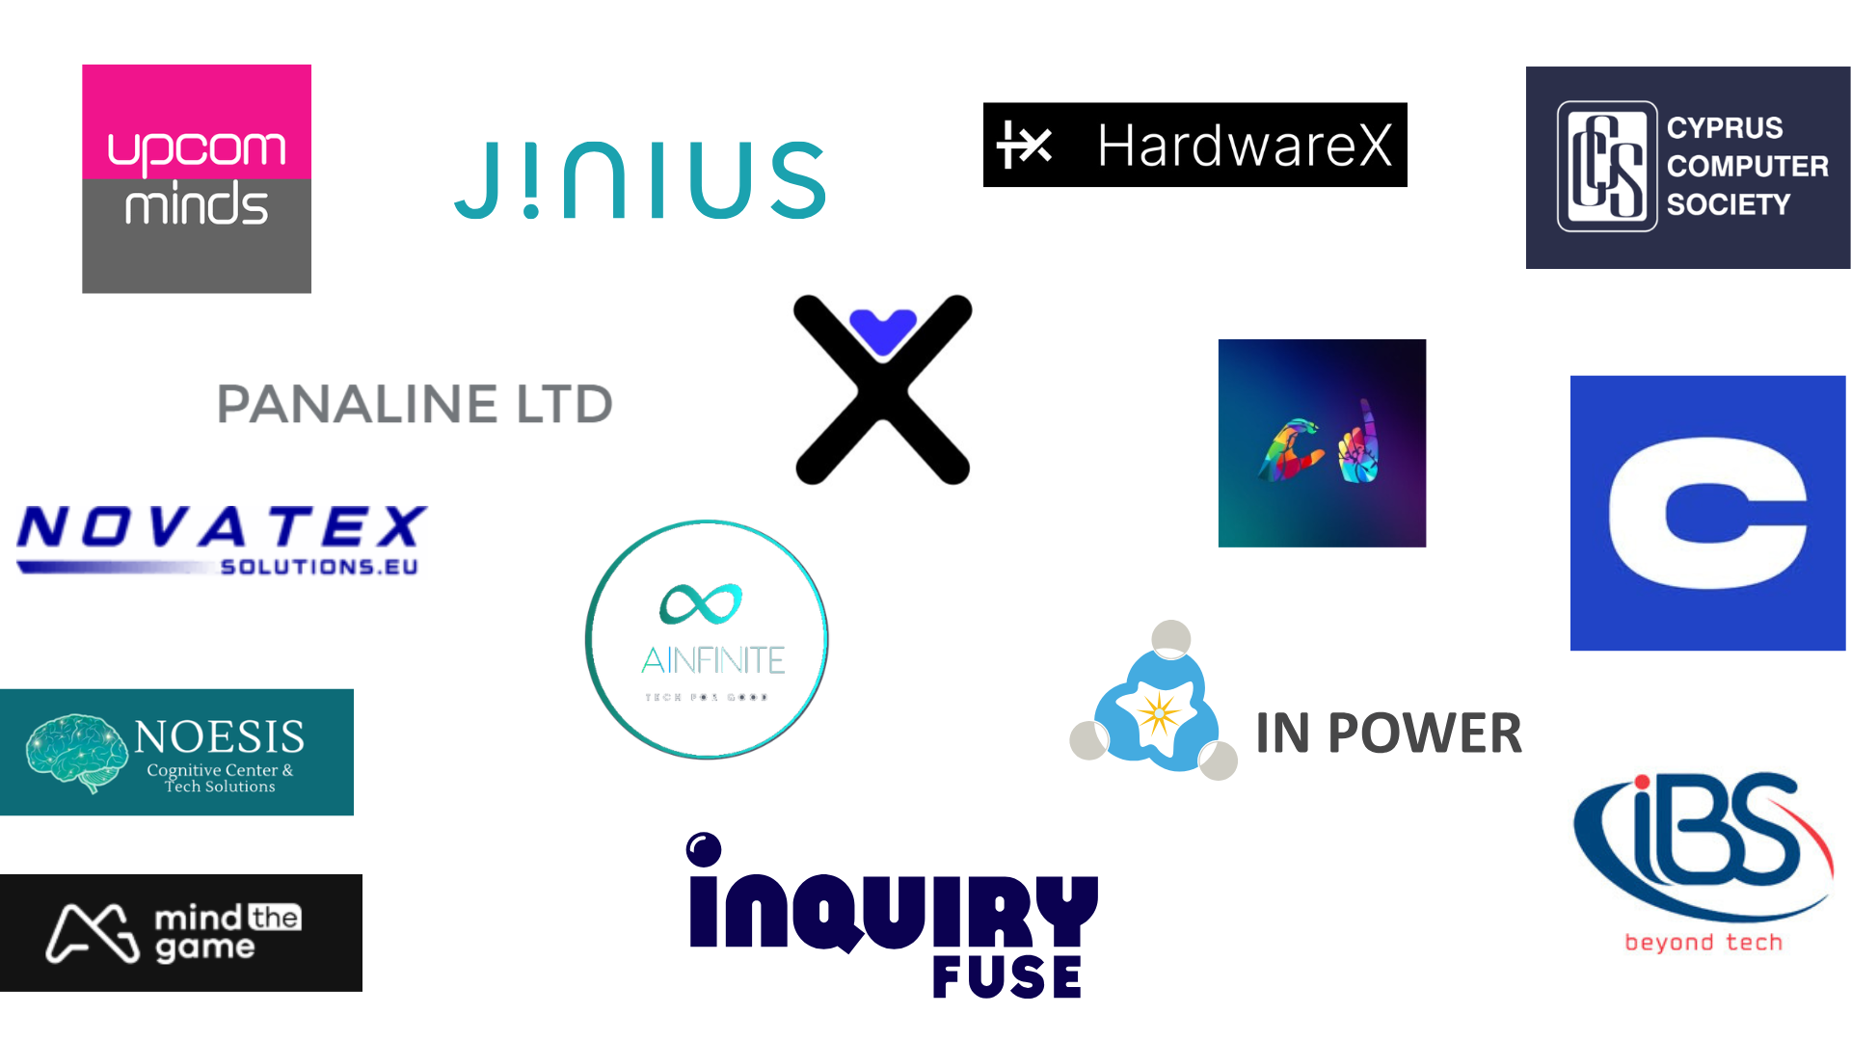
Mentors

Slide 7
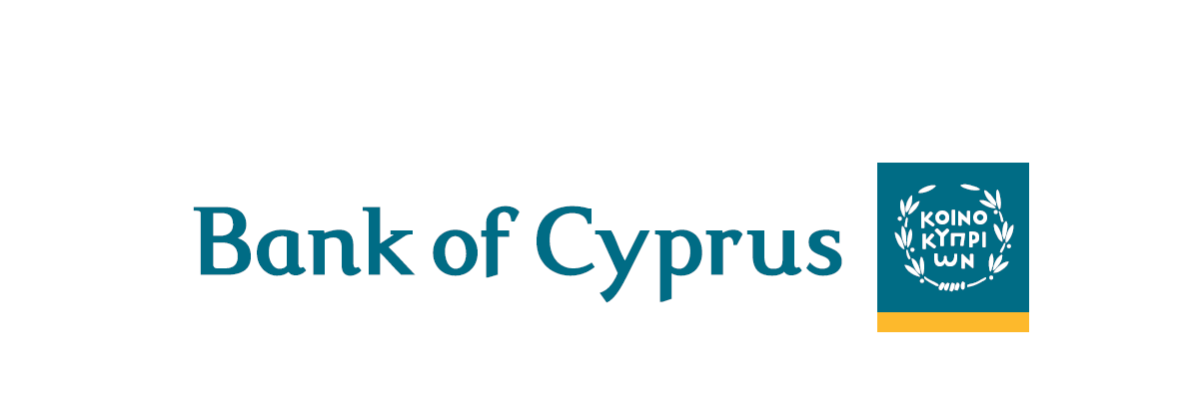
Sponsor
(Student Prizes)

Slide 8



Thank you for your attention and time, have a great day! All the Best!

