Slide 1
Team 12 | Sensewalk AI
Team: Pavlos Petrides, Andreas Constantinou, Theodoros Kontolemis
Date: 19th of June 2026
Venue: Frederick University, Limassol

Slide 2
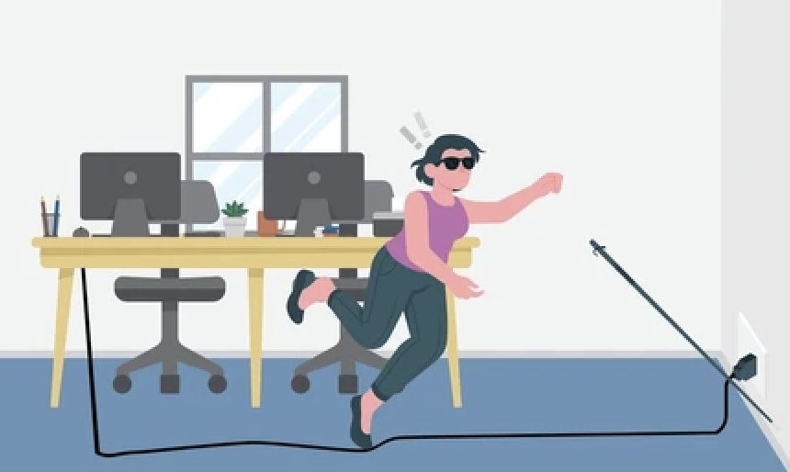
Problem Overview
A traditional white cane:
In real world environments it doesn’t detect everything
Relying solely on it is not optimal.
A blind person is limited in detection and in reaction time.

Slide 3
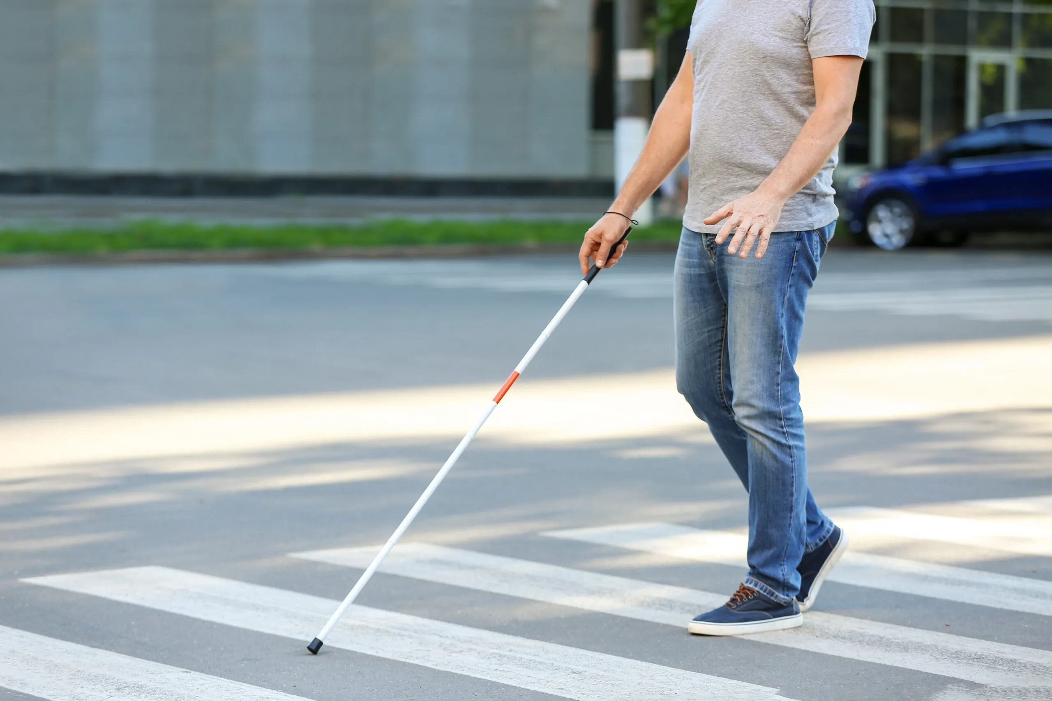
Motivation
Our primary goal is to restore autonomy, safety, and confidence
We believe independent mobility is a fundamental right
Our aim is to utilize AI to its fullest potential.

Slide 4
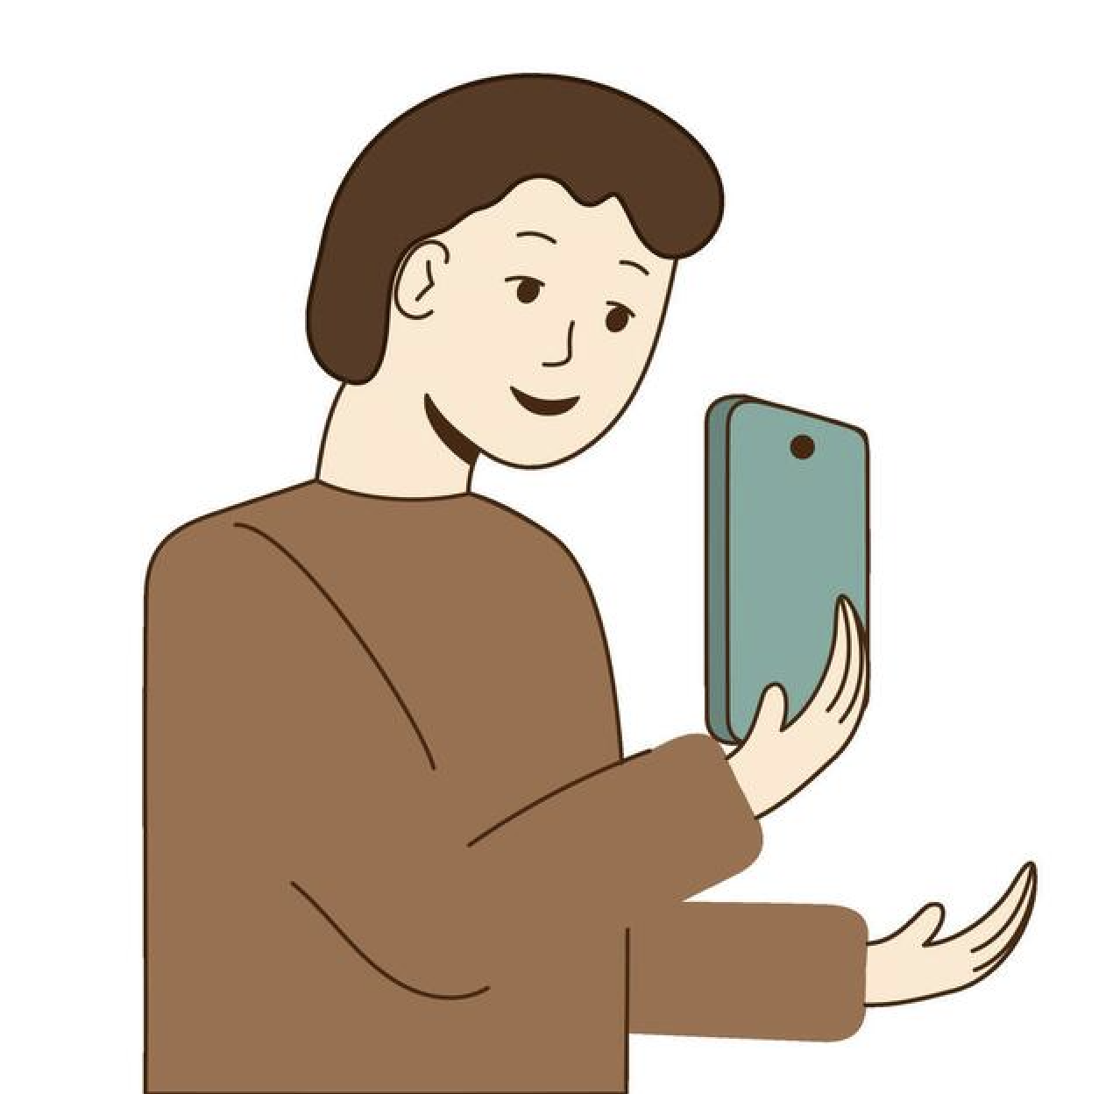
Solution
We developed a smart camera application that become your eyes.
Powered by real time AI computer vision.
It instantly detects upcoming obstacles and approaching pedestrians.
It cues immediate speech notifications, amongst other features.

Slide 5
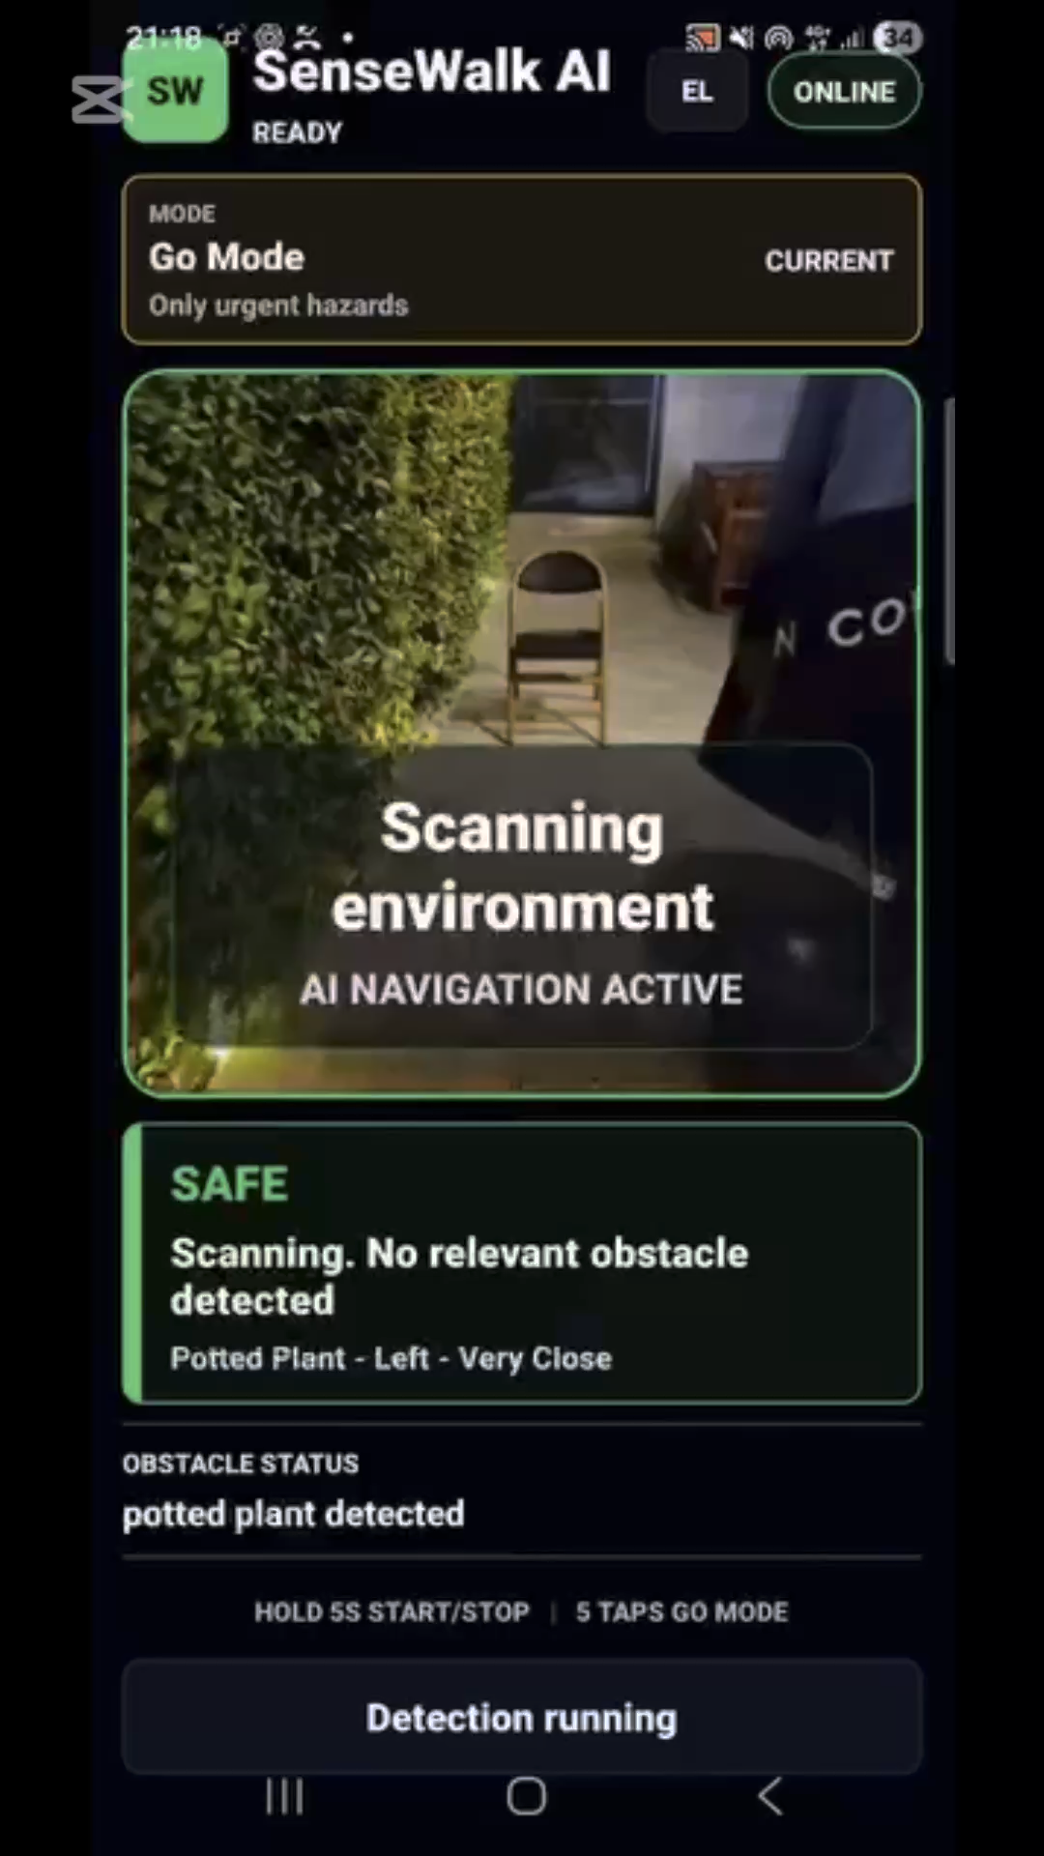
Demo Video

Slide 6

Mentors

Slide 7

Sponsor
(Student Prizes)

Slide 8



Thank you for your attention

