Slide 1
Team 13: EcoHome – Smart Appliance Scheduler
Team:
Ioanna Pataridou
Melanie Hasan
Elina Ioannou
Bianca Mihaela Nechita
Date: 19th of June 2026
Venue: Frederick University, Limassol

Slide 2
Problem Overview
Inefficient use of self-generated energy by homeowners or apartment tenants with PV systems installed causes:
Loss of self-produced energy
Overloading the grid and using practices that harm the environment
Increased costs due to higher demand from the grid

Slide 3
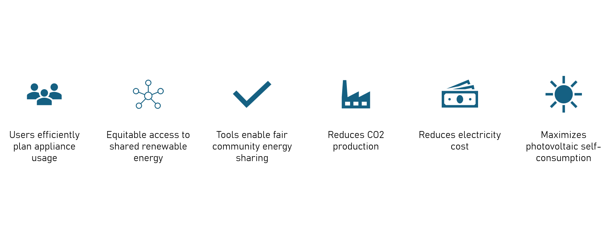
Motivation

Slide 4
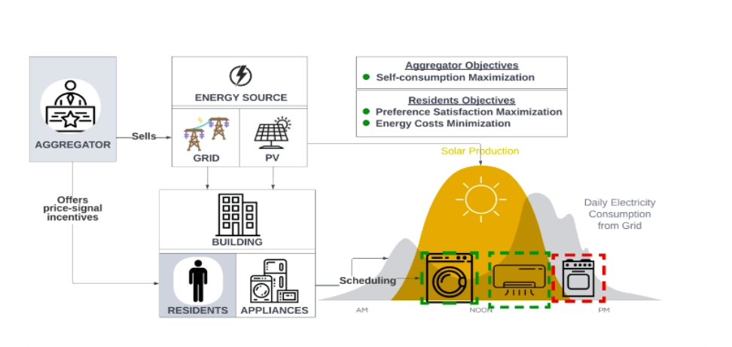
Solution
→ Max Self-consumption
Minimize energy demand from the grid.
Reduce reliance on CO₂-emitting fossil sources.
Maximize utilization of self-produced
renewable energy.
Meet energy needs efficiently.
Main Features
AI assisted appliance scheduling
Renewable energy peak optimization
Remote control & automation
Energy, CO₂ & cost savings tracking

Slide 5
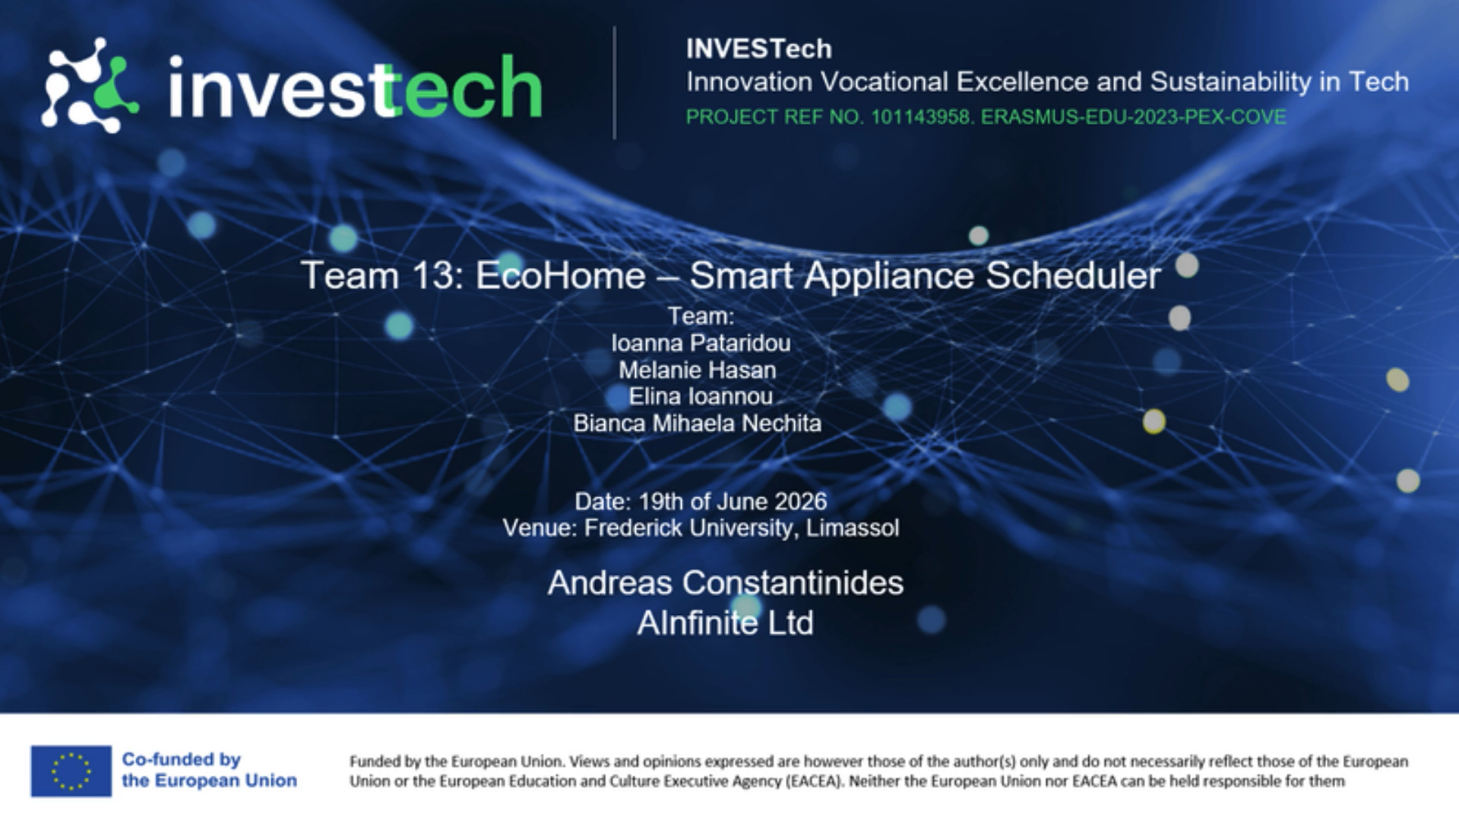
Demo Video

Slide 6

Mentors

Slide 7

Sponsor
(Student Prizes)

Slide 8



Thank you for your attention

