Slide 1
DigiThreatWatch
Team: Achilleos Dimitris
Nosov Mykola
Date: 17th of June 2026
Venue: Frederick University, Limassol

Slide 2

Problem Overview
People are increasingly targeted by online scams, misleading messages, and fraudulent content.
Many users struggle to recognise red flags, especially when scams appear convincing or use multiple formats like text, images, and audio.
This is especially challenging for users that lack basic digital skills.

Slide 3
Motivation
Help people avoid online scams and digital fraud.
Make it easier to understand whether a message, image, or audio is trustworthy.
Provide quick, AI‑powered guidance to keep users safe online.
Support vulnerable users who struggle to identify digital threats.

Slide 4
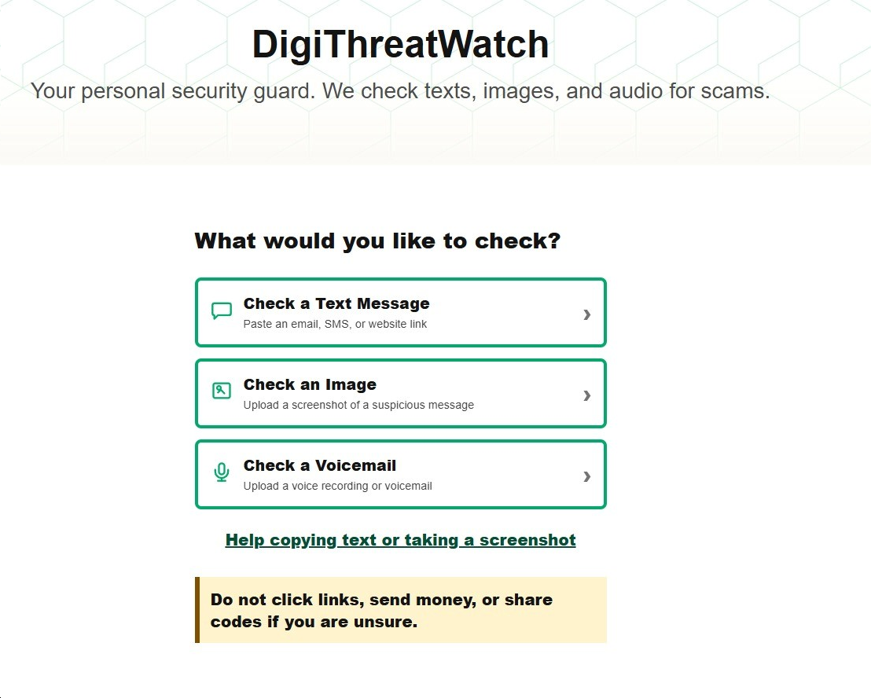
Solution
DigiThreatWatch
Multi‑modal Scam Detection
AI‑Powered Risk Assessment
Red Flag Identification
Actionable Safety Recommendations
URL Safety Checking

Slide 5
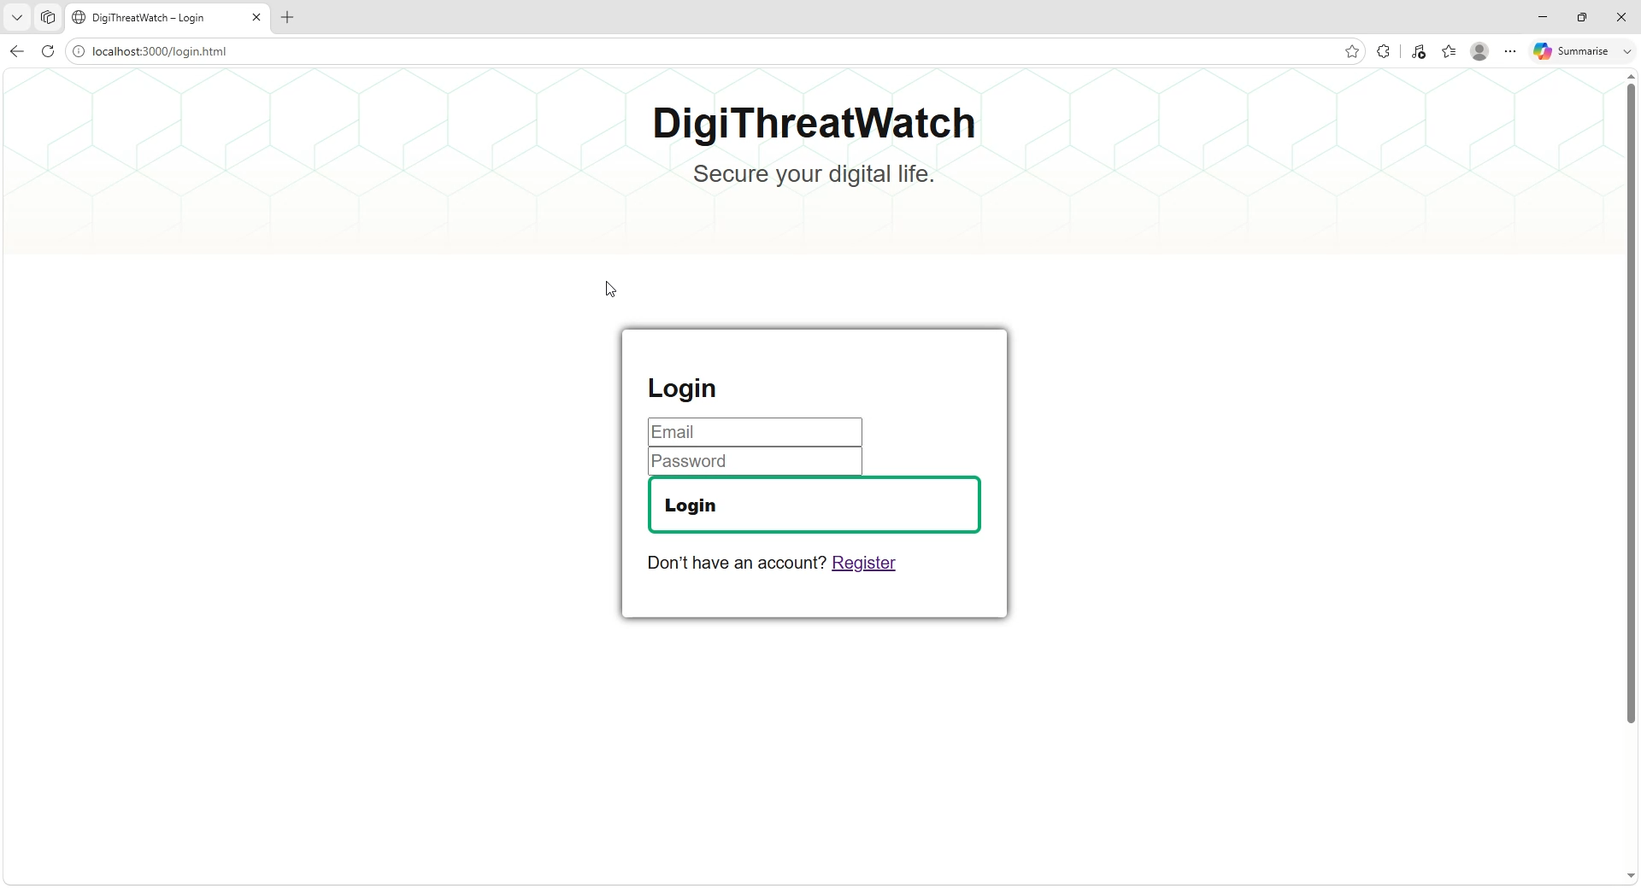
Demo Video

Slide 6

Mentors

Slide 7

Sponsor
(Student Prizes)

Slide 8



Thank you for your attention

