Slide 1
Team 15: DVI (Digital Vulnerability Index)
Team: Shreya Agrawal, Tavvishi Bhargava
Date: 19th of June 2026
Venue: Frederick University, Limassol

Slide 2
Problem Overview
Low Security Awareness
Security Risks
Daily Usage
Never taught how to stay safe online.
No Habit Tracking
Phishing
Weak Passwords
Shared OTPs
-Making digital security an afterthought
No Way to Measure Improvement
Email
Banking
Messaging
Browser
Addressing the issues that make us digitally vulnerable

Slide 3
Motivation
Most people use digital services daily but don’t know their own vulnerability level or how to improve.
Online safety training is boring, generic, and ineffective, leaving users uncertain and hesitant about what’s safe.
DVI gives clarity and confidence through a measurable Digital Vulnerability Index and personalized protection via adaptive micro‑quizzes.

Slide 4
Solution
Short 5-question quizzes tied to each app
Dynamic risk score (Low/Medium/High),
Built-in AI security coach for follow-up questions
AI-generated daily insights
Simulated phone dashboard with real apps
Full results history
Real-time dashboard: live screen-time tracker

Slide 5
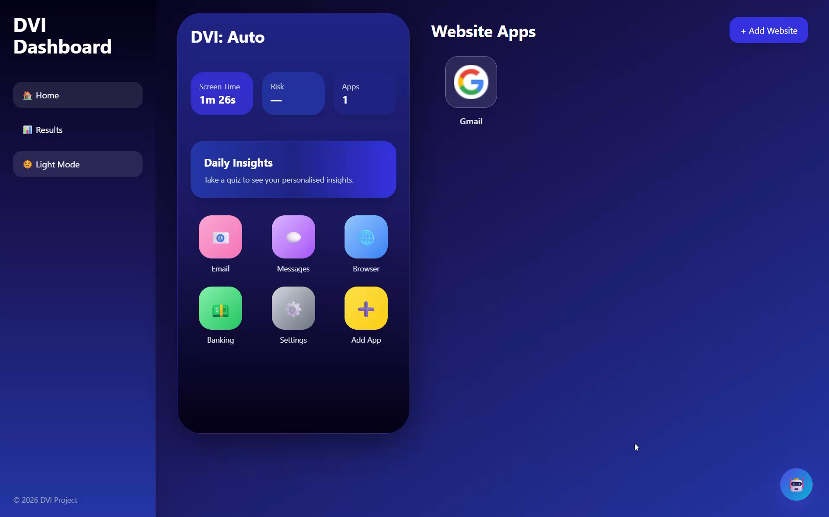
Demo Video

Slide 6

Mentors

Slide 7

Sponsor
(Student Prizes)

Slide 8



Thank you for your attention

