Slide 1
Team 1
ImmHelp
Team: Albert Mishurniaev, Artem Kondratenko, Konstantin Tomayly
Date: 19th of June 2026
Venue: Frederick University, Limassol

Slide 2
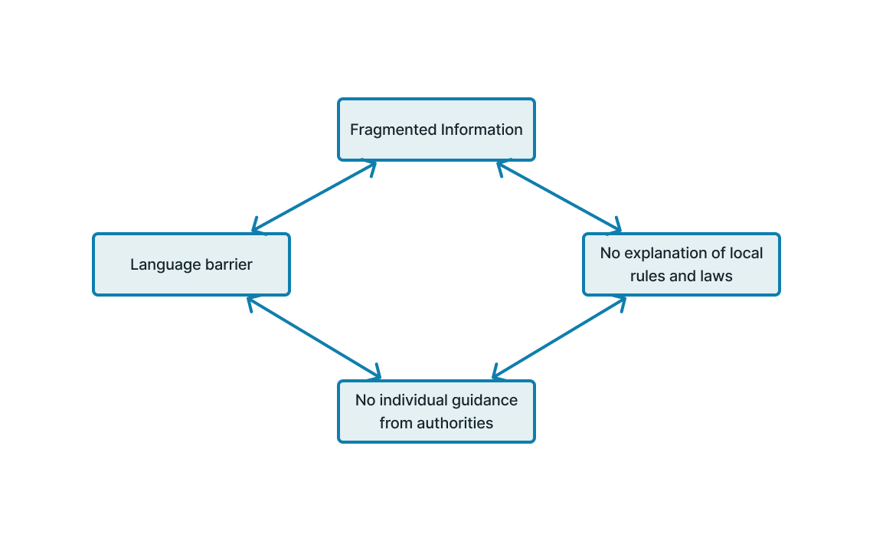
Problem Overview
Notes:
Information is fragmented and incomplete
The information that exists tells you what documents to bring but rarely the actual end-to-end process — and it's scattered across several different authorities (the Migration Department, the Department of Labour, the one-stop-shop, the Deputy Ministry, and diplomatic missions abroad), each responsible for a different part of immigration. Applicants are left stitching together partial document checklists from multiple sites, with no single source that walks them through the steps, the sequence, or the many caveats and exceptions.
There is no guidance tailored to the individual's situation
There is no single "Cyprus immigration process." The correct path depends entirely on who you are — your nationality (EU vs non-EU, UK post-Brexit), your purpose (work, study, family, digital nomad, investment), and income or status thresholds that change. Generic information can't tell an applicant which rules apply to them, so people follow the wrong route, prepare the wrong documents, and only discover the mismatch at the counter.
A language and bureaucratic barrier blocks access
Much of the official material and many forms are oriented toward Greek (with partial, sometimes outdated English) and written in dense legal-administrative language — with nothing in the first languages of most migrant communities. For newcomers who don't yet read Greek or legal English, even the information that is available is effectively locked away.

Slide 3
Motivation
Why we're building ImmHelp | Our story | Why it matters to us
We've lived the problem — our team came to Cyprus as immigrants ourselves We faced the same confusion, dead ends, and scattered information ImmHelp is the tool we wish we'd had | No single place told us what to do, in what order, or which rules applied to us The cost: lost time, wrong trips, second-guessing every step | We are NOT guessing the pain, we are the focus group for this product Cyprus is now feels like home Helping people adapt isn't just the product goal — it's personal
Notes:
Why we're building immhelp
We've lived the problem — our team came to Cyprus as immigrants ourselves
We faced the same confusion, dead ends, and scattered information
ImmHelp is the tool we wish we'd had
Our story
No single place told us what to do, in what order, or which rules applied to us
The cost: lost time, wrong trips, second-guessing every step
We got through it — but it was harder than it needed to be
We don't want the next person to start from zero
Why it matters to us
We are NOT guessing the pain, we are the focus group for this product
We know which moments are most confusing and stressful
Cyprus is now feels like home
Helping people adapt isn't just the product goal — it's personal

Slide 4
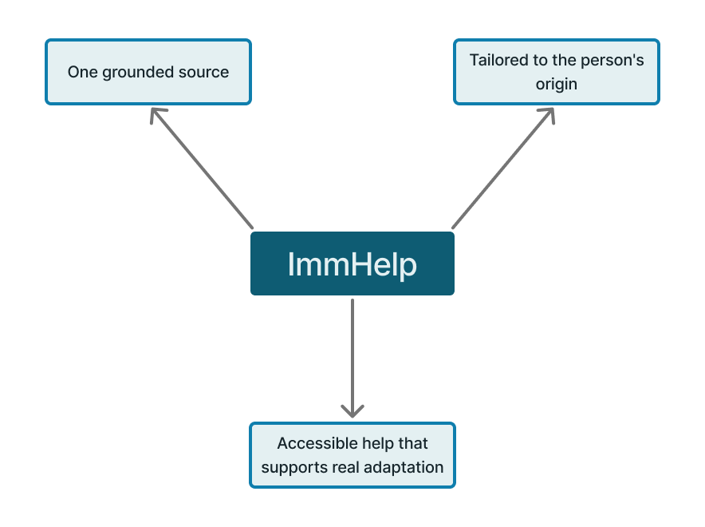
Solution
What immhelp is
Hard-to-read immigration info is turned into clear, personalised guidance
Grounded in the latest official sources
Tailored to where the person comes from
Built to help users settle into life in Cyprus — not just finish the paperwork
Notes:
What immhelp is
Hard-to-read immigration info is turned into clear, personalised guidance
Grounded in the latest official sources
Tailored to where the person comes from
Built to help users settle into life in Cyprus — not just finish the paperwork
How it works
Answers from the most recent bureaucratic and legal sources — current immigration-law documents and the Constitution of Cyprus
No guesswork or outdated forum posts
Gives an approximate, situation-aware answer for each question
Points the person to the right authority to resolve their case precisely — Migration Department, Department of Labour, the one-stop-shop, and so on
Guides, then hands off — users always know their next step and where to take it

Slide 5
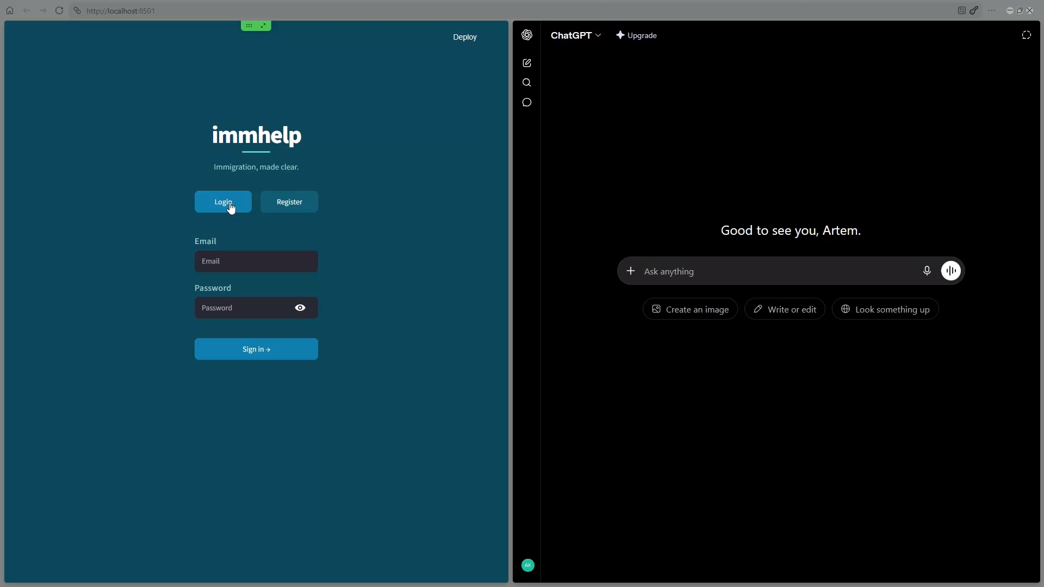
Demo Video

Slide 6
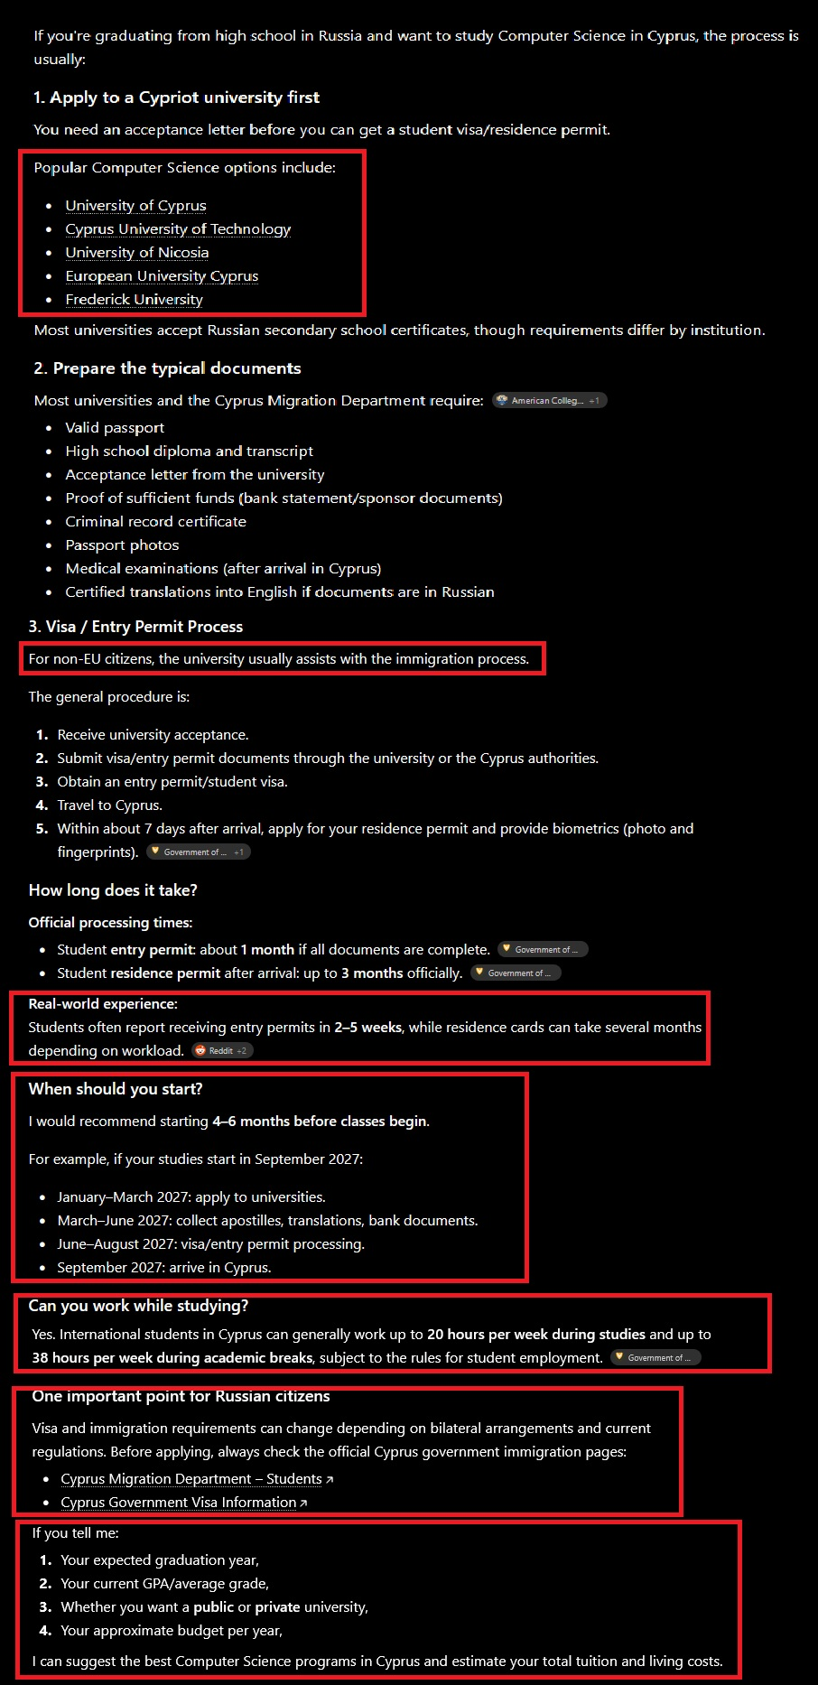
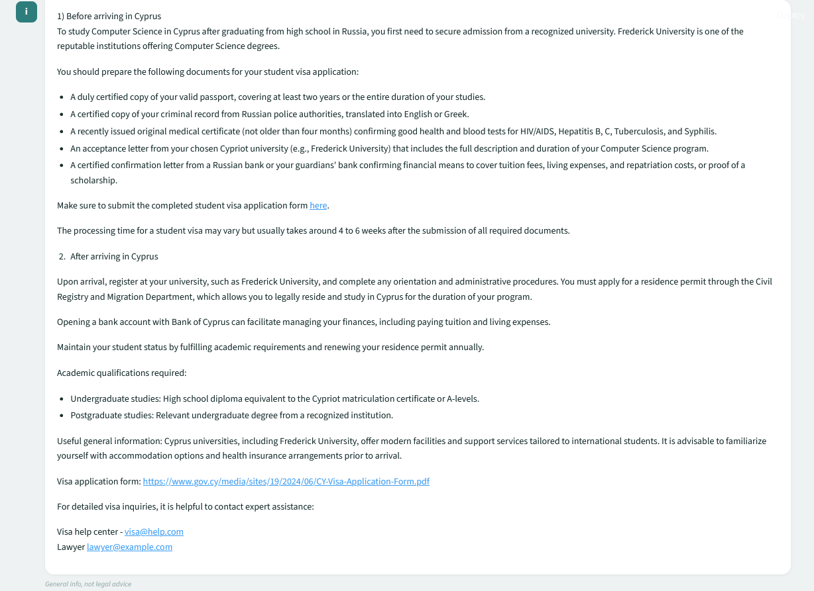
Comparison

Slide 7

Mentors

Slide 8

Sponsor
(Student Prizes)

Slide 9



Thank you for your attention

