Slide 1
Team 2: CiviCy
Team: Eleftheria Kyriakou
Katerina Dimosthenous
Date: 19th of June 2026
Venue: Frederick University, Limassol

Slide 2
Problem Overview
Scam/phishing messages have become more prominent than ever
In Cyprus, more than a €4 million lost through SMS scams in just the first half of 2025
Help the older population and people unfamiliar with technology
Most existing methods of scam detection are time consuming and unreliable

Slide 3
Motivation
Finding a tool that would be simple enough for everyone to use
Prevent sensitive information from reaching the hands of scammers
Help prevent financial loses
Instant feedback to users incase of emergency
Educate users about common scam tactics
Continuous improvement

Slide 4
Solution
Develop a mobile application using Kivy and Flask that allows users to submit suspicious messages
Compare message patterns with known scam indicators.
Use machine learning algorithms to analyse the content of messages.
Talk about the possibility of a message being a scam based on the analysis
Help users make informed decisions before responding to suspicious messages.

Slide 5
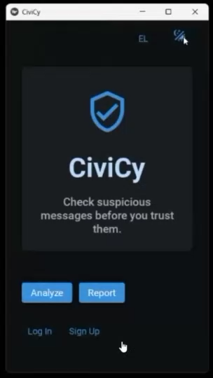
Demo Video

Slide 6

Mentors

Slide 7

Sponsor
(Student Prizes)

Slide 8



Thank you for your attention

