Slide 1
Team 3: Dyslexia Support Browser Extension
Team:
Date: 19th of June 2026
Venue: Frederick University, Limassol

Slide 2
Problem Overview
Most websites are not designed for dyslexic readers
Common struggles: letter confusion, losing place, complex vocabulary
No built-in tools to help on most websites

Slide 3
Motivation
Dyslexia affects 1 in 10 people
Existing solutions are expensive or incomplete
We wanted something instant, that works on any website

Slide 4
Solution
Chrome extension + Python backend
Page tools: dyslexia font, spacing, colour overlays, reading ruler
AI tools: read aloud, simplify text, define words, show syllables
Results shown in a large readable overlay using the user's own settings
All data saved to a SQLite database

Slide 5
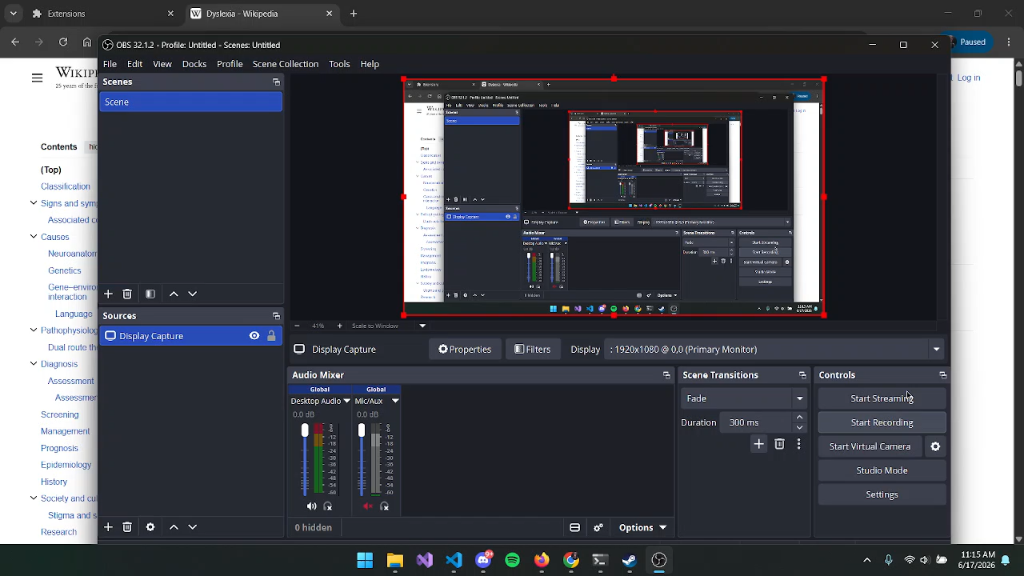

Slide 6

Mentors

Slide 7

Sponsor
(Student Prizes)

Slide 8



Thank you for your attention

