Slide 1
AccessNav
Team: Kyriakos Girgis
Romanos Neofytou
Marios Avgousti
Date: 19th of June 2026
Venue: Frederick University, Limassol

Slide 2

Problem Overview
Traditional navigation apps do not prioritize accessibility.
People with disabilities encounter barriers such as stairs, missing or broken ramps, broken pavements, and unavailable elevators.

Slide 3
Motivation
Promote independence and safety for people with mobility impairments.
Provide accessible route planning and real-time guidance.
Encourage community participation through accessibility reporting.

Slide 4
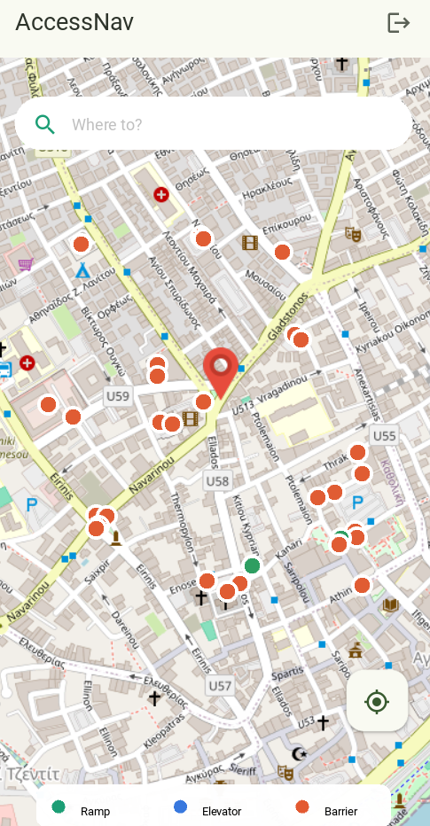
Solution
AccessNav
Wheelchair-accessible routing
Accessibility map layers
AR turn-by-turn navigation
Community barrier reporting

Slide 5
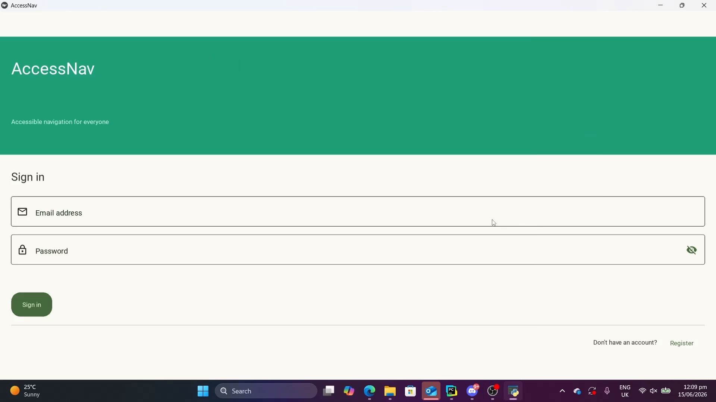
Demo Video

Slide 6

Mentors

Slide 7

Sponsor
(Student Prizes)

Slide 8



Thank you for your attention

