Slide 1
Peer-to-Peer Chat Platform with Mental Health Monitoring
Team 6
Stylianos Adamou
Ioannis Lambrou
Date: 19th of June 2026
Venue: Frederick University, Limassol
Notes:
Good morning. We are Team [Number], and our project is a peer-to-peer chat platform with built-in mental-health monitoring — technology designed not just to connect people, but to help keep them safe.
In the next four minutes we'll cover the problem we're tackling, why it matters to us, our solution, and a short demo.
(Timing tip: keep this opener to about 15 seconds and move quickly to the problem.)

Slide 2
Problem Overview
Many people show warning signs of emotional distress online before they ever seek professional help — and these signals often go unnoticed.
Today's chat platforms focus on communication — they do not actively identify users who may need mental-health support.
The result: at-risk individuals slip through the cracks, with no early path to help.
Warning signs go unnoticed
Notes:
Mental health is a global crisis. The World Health Organization estimates around 727,000 people die by suicide every year — roughly one death every 40 seconds — and it is the third leading cause of death among 15-to-29-year-olds. (WHO, 2021)
In the United States alone, 14.3 million adults reported serious thoughts of suicide in 2024, and the rate is highest among young people aged 18-25, at 12.6%. (NIMH / SAMHSA, 2024)
The key insight: people often signal distress online before they ever reach out for formal help — but today's chat platforms aren't built to notice. They move messages; they don't recognise someone in trouble.
And many never reach a professional at all: in one study of young people, only about 18% said they would likely turn to a mental-health professional, while nearly half would not seek help at all. So at-risk people slip through the cracks. (JMIR, 2019)

Slide 3
Motivation
We believe technology can do more than connect people — it can help protect them.
Our goal: a safer digital space where signs of self-harm or suicide are detected early, so people can reach help when they need it most.
By building mental-health awareness into the platform itself, we bridge the gap between vulnerable people and professional support.
Our vision: a trusted space that schools, communities, and even AI assistants can recommend when someone needs real support.
A safer space for everyone
Notes:
This matters to us because the tools people already use every day could be doing so much more.
Young people turn to the internet first: in one survey, over 80% said they would use their phone to look online for help with an emotional concern — largely because it feels anonymous and private. That same anonymity is what we build on. (JMIR, 2019)
Our goal is a safer digital space where warning signs are caught early and support is one tap away.
Looking further ahead — this is our vision — we want a trusted space that schools, communities, and even AI assistants can point people to. People already turn to AI for emotional support: a 2024 survey found 70% of teens have used generative AI, and companion apps. The need is real — we want to meet it responsibly. (Common Sense Media, 2024)

Slide 4
Solution
A peer-to-peer chat platform with built-in mental-health monitoring.
Real-time, anonymous peer-to-peer messaging
Detects self-harm and suicide-related language as people chat
Flags concerning messages and instantly surfaces support resources
Admin dashboard to review flagged incidents and trends — on a secure, scalable architecture
Our edge: anonymous by design + early intervention before a crisis.
Chat that looks out for you
Notes:
So here is what we built: a peer-to-peer chat platform with monitoring underneath.
People message in real time and anonymously. As they chat, the system scans for self-harm and suicide-related language. When something concerning appears, it flags the message and instantly surfaces support resources to that user. Admins can review flagged incidents and trends on a dashboard — all on a secure, scalable backend.
Our edge is the combination: anonymous by design, so people open up without fear of judgment, and early intervention, catching warning signs before a situation becomes a crisis.
Important point on responsibility: we don't diagnose and we don't replace professionals — we redirect, and connect people to real help. That distinction is central to how we built it

Slide 5
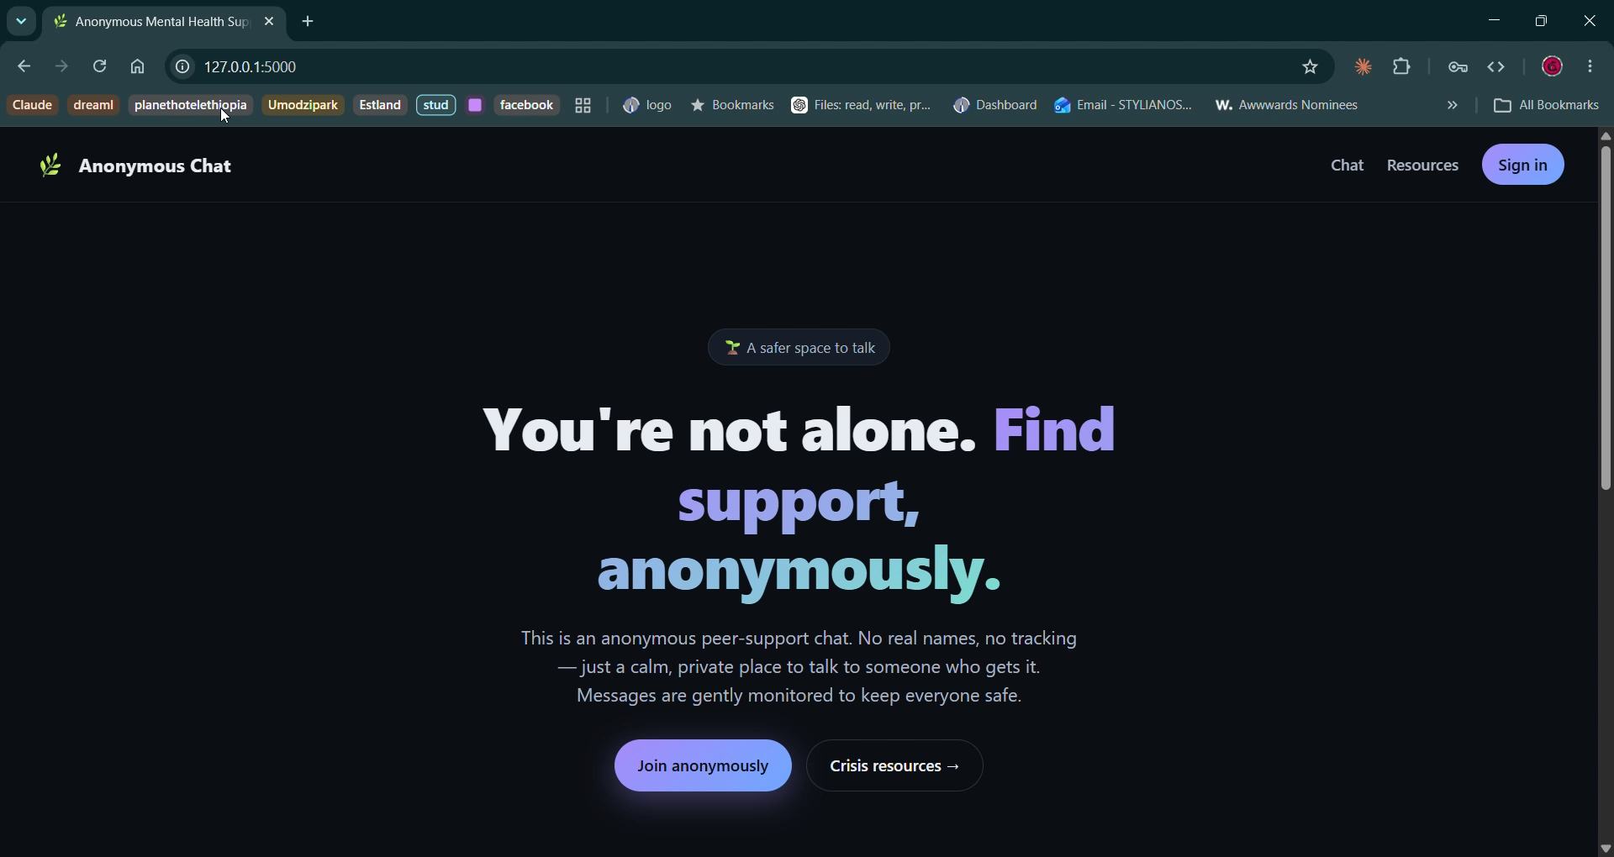
Demo Video
A short live walkthrough of the platform in action.
[ Embed your demo video here, or switch to it live ]
Notes:
Let me show you how it works in practice. [Play the demo video.]
As it plays, walk the judges through the five steps: 1) a user sends a message; 2) the system analyses the content; 3) high-risk language is detected and flagged; 4) the user is immediately shown relevant support resources; 5) administrators see the trend on the dashboard.
Backup plan: if the video won't play, just describe these five steps out loud and keep moving — don't stall on the tech.

Slide 6

Mentors
Notes:
None of this would have been possible without the guidance of our mentors at [Mentor Company] — thank you for your support and feedback throughout the project.
(Reminder: add your mentor's logo to this slide.)

Slide 7

Sponsor
(Student Prizes)
Notes:
We'd also like to thank [Sponsor] for sponsoring the student prizes and supporting young innovators like us.
(Reminder: add your sponsor's logo to this slide.)

Slide 8



Thank you for your attention
Notes:
To sum up: people are already reaching out online — and increasingly to AI — when they are struggling. We want to make sure that when they do, there is a safe, anonymous space that notices and connects them to real human support.
That's the future we're building. Thank you for your attention — we're happy to take any questions.
(Timing tip: aim to finish the spoken pitch around 3 minutes 40 seconds, leaving a buffer for questions.)

