Slide 1
Team 7: Social Isolation Monitoring Dashboard
Team:
Date: 19th of June 2026
Venue: Frederick University, Limassol

Slide 2
Problem Overview
Social isolation is a hidden crisis
Millions of people struggle silently with loneliness, stress, and emotional difficulties.
Many want help, but they face barriers:
They don't know where to find support
Support services are scattered and hard to discover
Many hesitate to ask for help because of stigma
People worry about sharing personal information
NGOs struggle to identify people who need support early

Slide 3
Motivation
Making support easier to reach
Even when help exists, many people never take the first step.
We wanted to create a platform that:
Provides a safe first step for people who feel alone
Allows users to express themselves without pressure
Protects privacy and builds trust through anonymity
Bridges the gap between individuals and support organizations
Helps people find the right help before problems grow

Slide 4
Solution
A safe bridge between people and support
We created a privacy-first platform that helps people express what they are going through and find the right support.
For Individuals
AI-guided check-in
A safe conversation to understand their needs
Personalized support matching
Suggests relevant NGOs and resources
User-controlled privacy
Users decide when to share their information
For NGOs
Support dashboard
Understand social needs and demand trends
Community insights
Identify areas where support is needed
Better outreach
Connect with people who request help

Slide 5
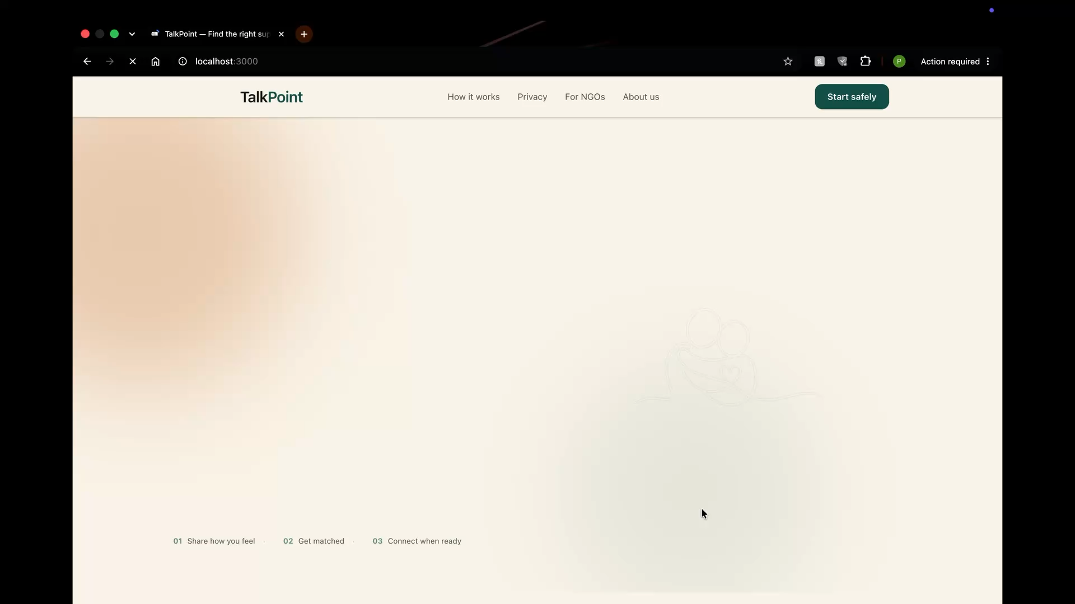
Demo Video

Slide 6

Mentors

Slide 7

Sponsor
(Student Prizes)

Slide 8



Thank you for your attention

