Slide 1
Team number and Title
Team:
Date: 19th of June 2026
Venue: Frederick University, Limassol

Slide 2
ACSC-390- Software Engineering Placement
Kyriakos Pamporis
Antreas Louca
Andreas Michael

Slide 3
Problem Overview
Many communities contain people who need assistance with everyday tasks and people who are willing to help
No centralize place to request or offer help
Community support effort can become inefficient and unorganized

Slide 4
Motivation
Increase communication engagement and encourage more people and businesses to help others
To make requesting help easier
To improve coordination between volunteers and businesses

Slide 5
Solution
To create a web platform for community assistant
Allow people to register as volunteers and businesses as partners
To track requests
Improves visibility between those who want to help and those who want to provide

Slide 6
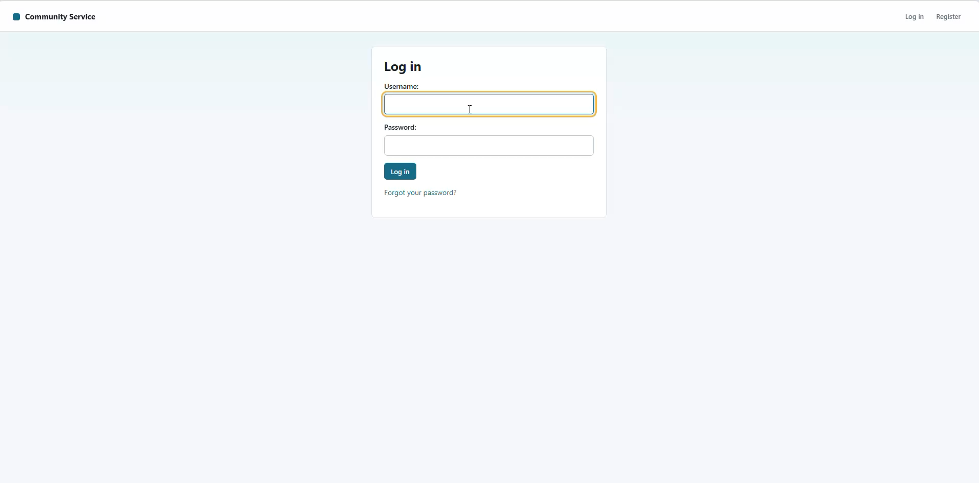
Demo Video

Slide 7
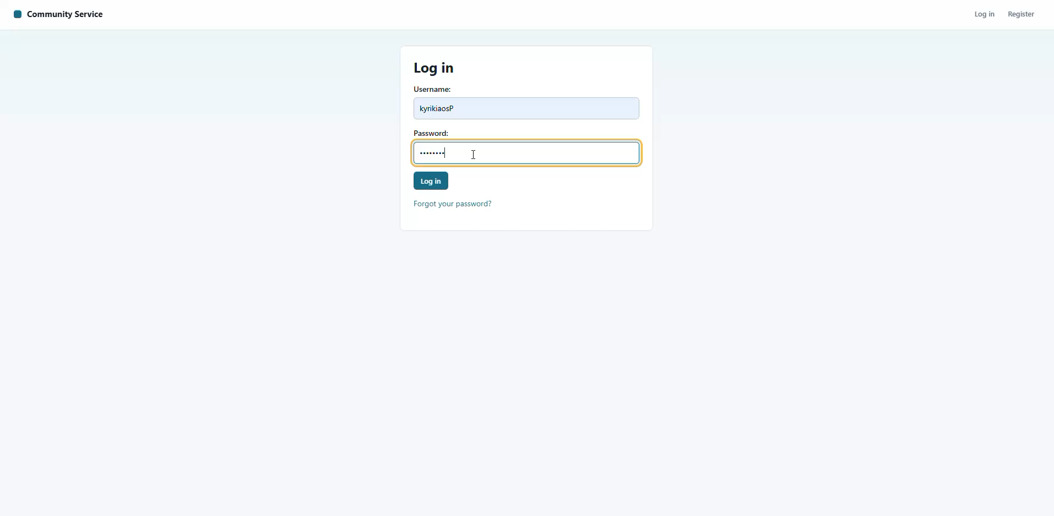
Demo Video

Slide 8
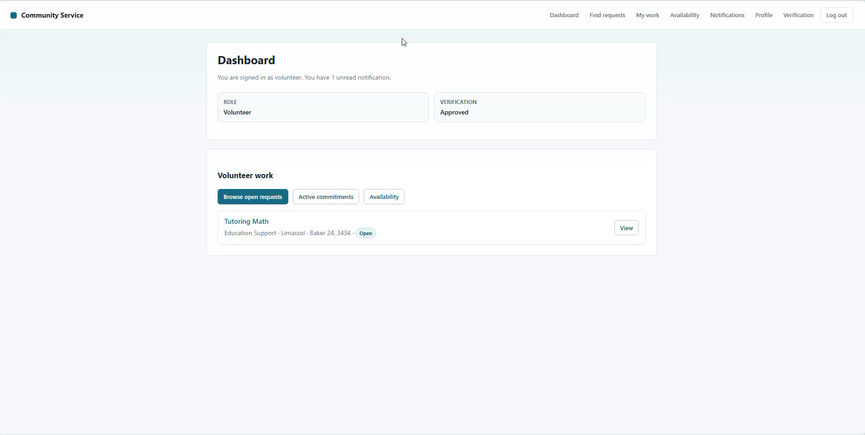
Demo Video

Slide 9
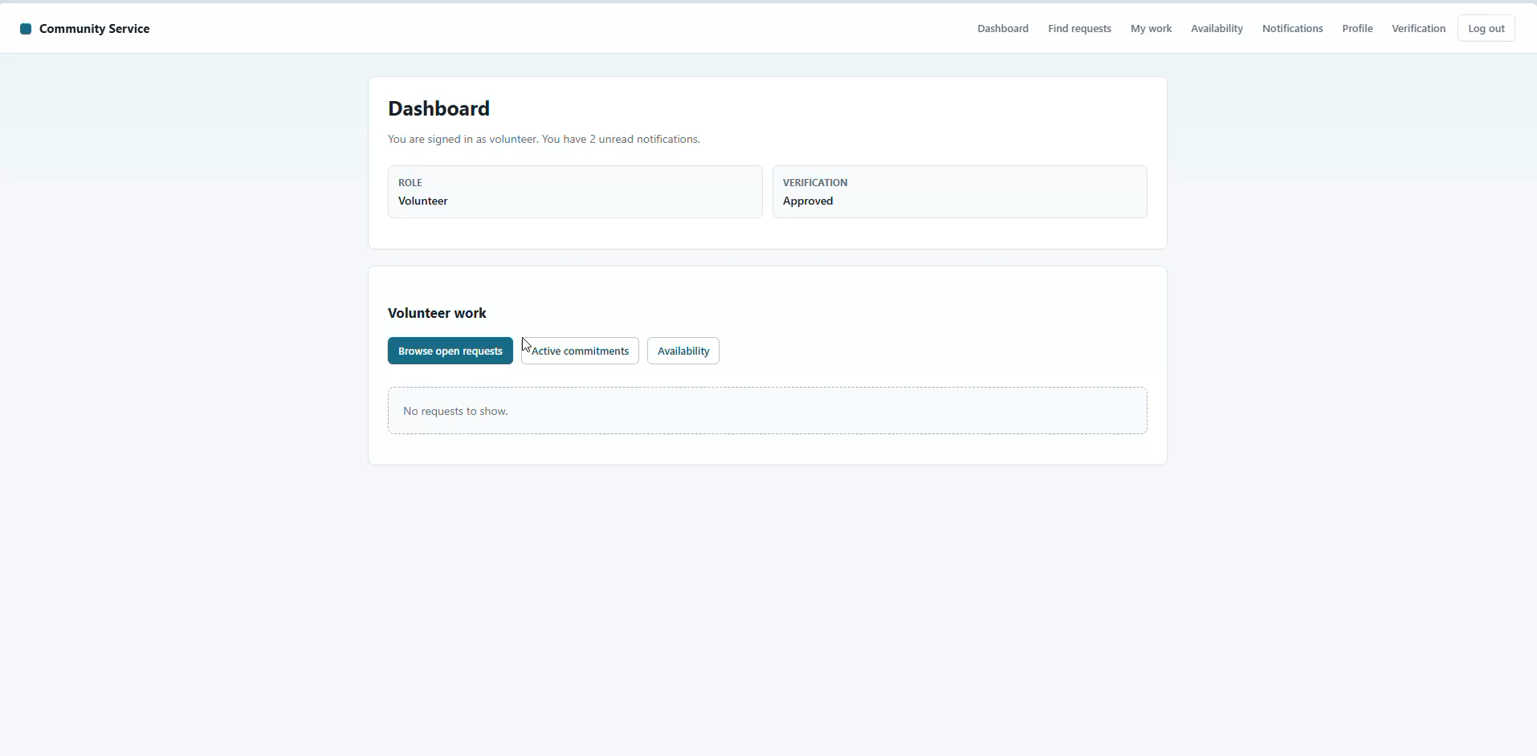
Demo Video

Slide 10

Mentors

Slide 11

Sponsor
(Student Prizes)

Slide 12



Thank you for your attention

