Slide 1
Title : Inclusive Micro-Learning Application
Team: 9
Date: 19th of June 2026
Venue: Frederick University, Limassol

Slide 2
Problem Overview
Many older adults face challenges when using digital technology.
Modern websites and applications can be confusing.
Learning platforms often assume prior digital knowledge.
Small text and complex interfaces reduce accessibility.
Lack of confidence prevents many users from developing essential digital skills.

Slide 3
Motivation
Why is this important?
Promote digital inclusion for older adults.
Help users gain confidence when using technology.
Provide a safe environment to learn digital skills.
Support accessibility through simple design and assistive features.
Target Users
Older adults
Beginner technology users
Users who benefit from accessibility support

Slide 4
Solution
Key Features
6 beginner-friendly digital literacy courses
Interactive quizzes and activities
Progress tracking and achievement badges
Read Lesson Aloud functionality
Large Text accessibility mode
High Contrast accessibility mode
Future Development
Personalized learning paths
Additional learning modules
Expanded accessibility options

Slide 5
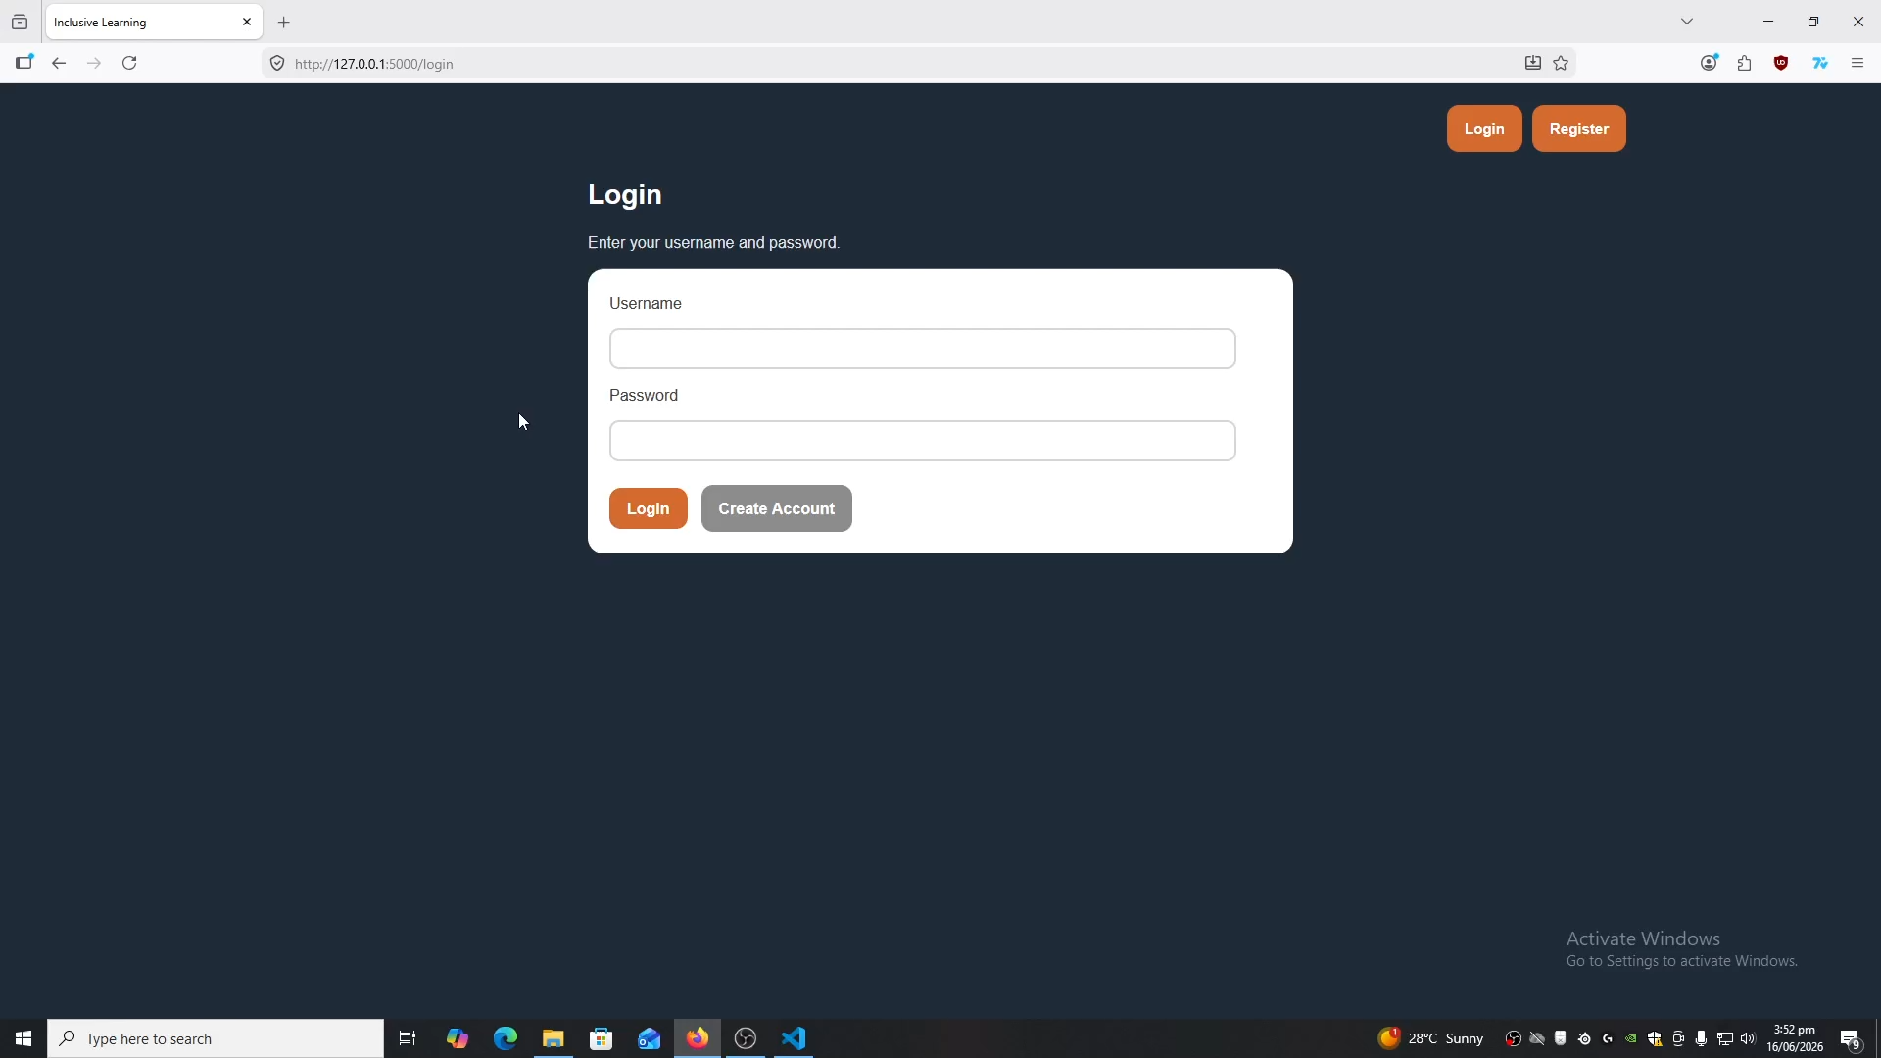
Demo Video

Slide 6

Mentors

Slide 7

Sponsor
(Student Prizes)

Slide 8



Thank you for your attention

